Slide 1
HL7 Australia FHIR Symposium
Grahame Grieve
16 June 2015
© 2013 Health Intersections. Licensed under Creative Commons. FHIR, HL7, Health Level Seven are registered trademarks of Health Level Seven International. Reg. U.S. TM Office.

Slide 2
Overview of Days
Today
Introduction / Status
Collaborations + Claims & Terminology Services
Connectathons + FHIR in Australia
FHIR in NZ + Future directions / discussion
Tomorrow: Connectathon
More about this after lunch

Slide 3
Presenters
Grahame Grieve
FHIR Project Lead, FHIR Governance Board, FHIR Infrastructure
http://www.healthintersections.com.au
David Hay
FHIR Management Group, Leading FHIR advocate
http://fhirblog.com
Heather Grain
HL7 Vocabulary, HL7 Terminology Authority

Slide 4
FHIR Contributors, Australia & NZ
Grahame Grieve, David Hay, Heather Grain
Brian Postlethwaite – FMG + PA WG editor
Brett Esler – Implementer / Tester + AU editor
Vince McCauley – Services co-chair + CC
Stephen Chu
Andy Bond / Reuben Daniels - Architecture / Implementation
Stephen Royce / David McKillop – Testing profiling

Slide 5
Session #1
Grahame: Welcome, Overview
David: Introduction to FHIR
Grahame: Current Status Report

Slide 6
Insert David’s Slides here (FHIR introduction)

Slide 7
Current Status Report
Conceived May/June 2011
DSTU #1 – published End of Jan 2014
DSTU #2
Draft Ballot Dec/Jan 2015
DSTU Ballot April/May 2015
1200 comments
Reconciliation is happening now
All content on http://gforge.hl7.org/gf/project/fhir/tracker/
Plan to publish DSTU in Late August/Sept

Slide 8
Overall progress
DSTU #1 was very early ‘beta’
Many untested ideas, some very draft resources
DSTU #2 is late ‘beta’
Infrastructure has had a lot of use
Some resources have had a lot of use
Some resources are very new and untested

Slide 9

FHIR Maturity Model
FMM0 = published on current build
FMM1 = FMM0 + no warnings & ready for testing
FMM2 = FMM1 + has been tested at Connectathon
FMM3 = FMM2 + formal balloting, at least 10 implementer comments resulting in substantive change
FMM4 = FMM3 + tested across scope, formal publication, multiple prototype projects
FMM5 = FMM4 + two formal publications, implemented in at least 5 systems in multiple countries

Slide 10
Important Resources: Maturity
Resource | Level |  | Resource | Level
Patient | 5 |  | Medication* | 0
Encounter | 0 |  | Practitioner | 3
Observation | 4 |  | Organization | 4
DiagnosticReport | 3 |  | Location | 1
Condition | 0 |  | List | 0 (3)
AllergyIntolerance | 0 |  | Bundle | 3
Procedure | 0 |  | ValueSet | 4
CarePlan | 0 |  | Composition | 2

Slide 11
Overall Progress
What we expected
Scattered adoption by greenfields solutions (mainly social media driven)
Gradual growth of focus on FHIR at HL7
What actually happened
Adoption across new platforms (at least one national EHR)
Prototypes & implementations from many members including national programs
FHIR dominates HL7 agenda now
0% of US hospitals use FHIR

Slide 12
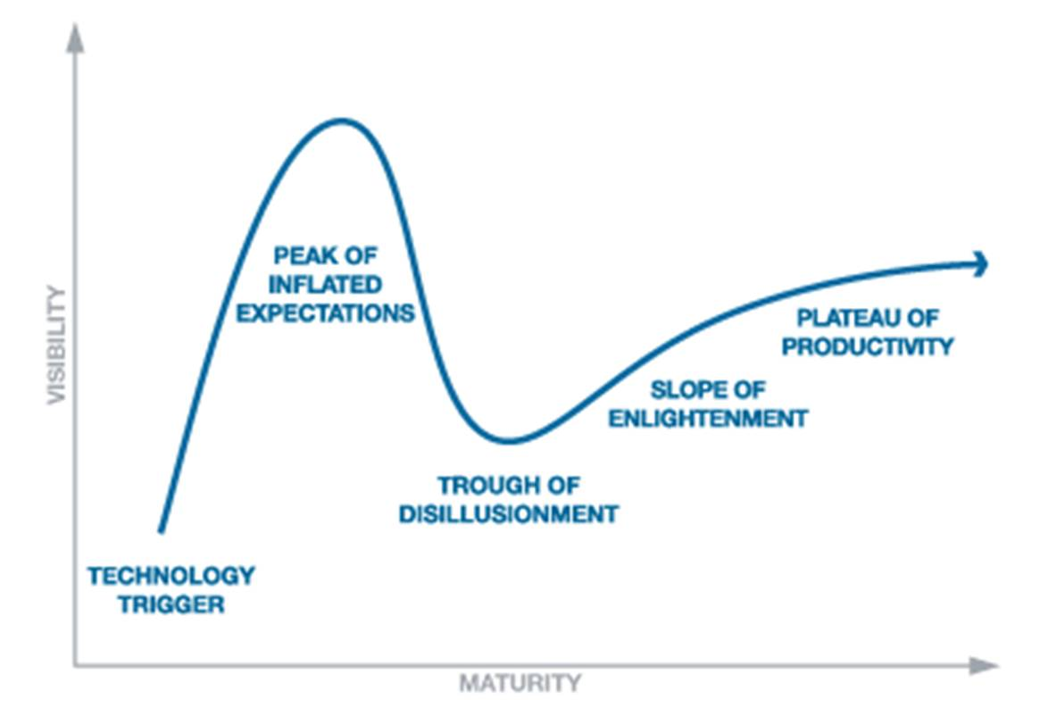
Trough of Disillusionment?
Trough: FHIR doesn’t solve all interoperability problems

Slide 13
Problems FHIR doesn’t solve
Can’t make hard problems easy
Can’t force people to want to interoperate
Can’t make interoperability easy (data and processes really differ)
Full scope of healthcare is very broad

Slide 14
Problems FHIR does solve
Simple specification implementers can easily engage with & like (5-5-5)
Solid computable base (ontologies, terminologies, computable conformance layer)
Open license (free)
Strong Collaboration / Engagement process
Covers most important content for exchange

Slide 15
Future Directions
Later today…

Slide 16
Morning Break

Slide 17
Collaborations
DICOM
IHE
ONC: DAF, CQI, SDC
Argonaut
HSPC

Slide 18
DICOM
Joint DICOM / HL7 Working group = Imaging Integration
Integrating Image management into wider healthcare context
2 resources:
ImagingStudy – record of DICOM imaging study
ImagingObjectSelection – Selected set of DICOM images e.g. for DiagnosticReport
Both make links available in EHR

Slide 19
IHE
IHE Engagement is deep and broad
Started with Mobile Health Documents (‘XDS on FHIR’)
Many IHE profiles on FHIR under development now

Slide 20
ONC
Office of the National Coordinator (for healthcare IT)
Works with HL7 on specifications to support efforts to transform US healthcare system
Uses FHIR for 3 projects:
SDC: Structured Data Capture
DAF: Data Access Framework
CQI: Clinical Quality Initiative

Slide 21
SDC: Structured Data Capture
Scope:
Creation and population of forms with patient-specific data
a mechanism for linking questions in forms to pre-defined data elements
automatically populate portions of the form based on existing data

Slide 22
SDC Profiles
DataElement: auto-populate form data based on questionnaire links
ValueSet: define allowed values for data elements and for questions in questionnaires
Questionnaire: define form definitions (manual and/or automatic population)
QuestionnaireAnswers: share data captured using questionnaire forms

Slide 23
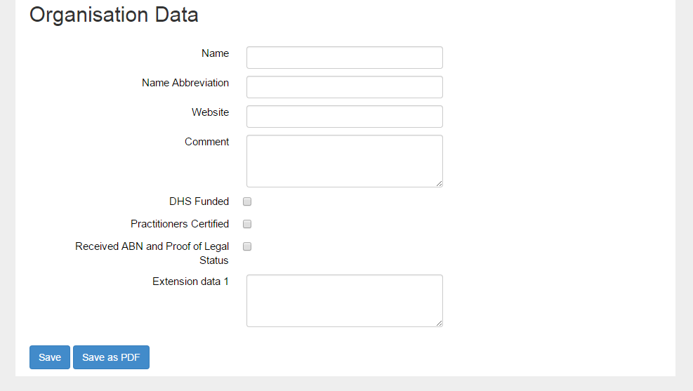
Ackn. HealthConnex

Slide 24
Example SDC workflow
Doctor decides to refer patient to a healthcare service
Looks up service on Healthcare Service Directory, makes appointment, gets a data entry form
Doctor’s system fills out the parts of the form it can
Doctor fills out the rest of the form
System submits the form as part of the referral

Slide 25
DAF (Data Access Framework)
Allow access to data stored in Health IT systems
Goals
Better understand an individual patient health
Understand a provider’s patient population
Understand the entire populations health
E.g. make data available for secondary data analysis

Slide 26
DAF Work
2 parts for the DAF project
What Meaningful Use data looks like in FHIR
High level specifications for what systems must be able to exchange
Not specific to DAF, but no one else had done it
What is required to ‘give access to the data’
Security / Context
Search Parameters (paths into the data)

Slide 27
Meaningful Use Data
Patient name / Sex / Date of birth / Race / Ethnicity / Preferred language
Smoking status
Problems
Medications
Medication allergies
Laboratory test(s)
Laboratory value(s)/result(s)
Vital signs – height, weight, blood pressure, BMI
Care plan field(s), including goals and instructions
Procedures
Care team member(s)
Documents relating to a patient

Slide 28
DAF Profiles
Meaningful Use conceptual data element | DAF profile
Medication allergies | DAFAllergyIntolerance
Laboratory Order(s) | DAFDiagnosticOrder
Laboratory Test(s) | DAFDiagnosticReport
Encounter Diagnoses | DAFEncounter
Family Health History | DAFFamilyMemberHistory
Immunizations | DAFImmunization
Laboratory Result Value(s) | DAFLabResults
Medications | DAFMedication,DAFMedicationStatement, DAFMedicationAdministration, DAFMedicationDispense, DAFMedicationPrescription
Patient name, Sex, Date of Birth, Race, Ethnicity, Preferred Language | DAFPatient
Problems | DAFCondition (Problem)
Procedures | DAFProcedure
Smoking status | DAFSmokingStatus
Vital Signs (Height, weight, BP, BMI) | DAFVitalSigns
MedicationAllergies list, Problem list, Medication List, Immunizations, Encounters, Laboratory Result Values | DAFAllergyIntoleranceList, DAFProblemList,DAFMedicationList, DAFImmunizationList,DAFEncounterList, DAFResultsList
 | DAF Supporting Profiles:DAFOrganization, DAFLocation,DAFPractitioner, DAFSubstance,DAFRelatedPerson

Slide 29
CQI: Clinical Quality Initiative
A set of FHIR profiles that implement the Quality Information and Clinical Knowledge (QUICK) logical model
So you can use the Clinical Quality Language (CQL) against data made available through the FHIR API
Encouraging consistent access and use of data for clinical quality applications, across organizations and between healthcare systems

Slide 30
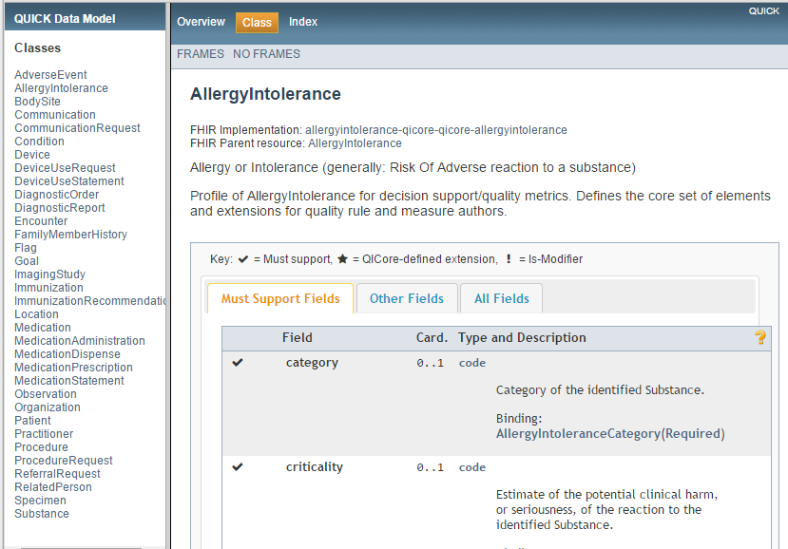
QUICK Model
QI-Core is only publication of QUICK?

Slide 31
CQI Problems
Overlaps with DAF. Imperfectly harmonised
It’s a simplified data model
Not clear how useful a simplified view of healthcare data will be for clinical quality rules
Not clear how US specific this is or should be

Slide 32
QI-Core Profiles
QICore-AdverseEvent | QICore-ImmunizationRecommendation
QICore-AllergyIntolerance | QICore-Location
QICore-BodySite | QICore-Medication
QICore-Communication | QICore-MedicationAdministration
QICore-CommunicationRequest | QICore-MedicationDispense
QICore-Condition | QICore-MedicationPrescription
QICore-Device | QICore-MedicationStatement
QICore-DeviceUseRequest | QICore-Observation
QICore-DeviceUseStatement | QICore-Organization
QICore-DiagnosticOrder | QICore-Patient
QICore-DiagnosticReport | QICore-Practitioner
QICore-Encounter | QICore-Procedure
QICore-FamilyMemberHistory | QICore-ProcedureRequest
QICore-Flag | QICore-ReferralRequest
QICore-Goal | QICore-RelatedPerson
QICore-ImagingStudy | QICore-Specimen
QICore-Immunization | QICore-Substance

Slide 33
Argonaut
JASON Taskforce Report https://www.healthit.gov/facas/sites/faca/files/Joint_HIT_JTF%20Final%20Report%20v2_2014-10-15.pdf
“JASON recommends that healthcare interoperability be reoriented away from "siloed legacy systems" toward a centrally orchestrated interoperability architecture based on open APIs and advanced intermediary applications and services”
API Based access will be critical to MU3 regulations
Which API? There is only one…. But what exactly will it say?
Argonaut project (“Jason’s team”) work with HL7 to create a path for MU3 regulations
Key US stakeholders including large vendors
Make sure FHIR is ready on time & suitable and understood

Slide 34
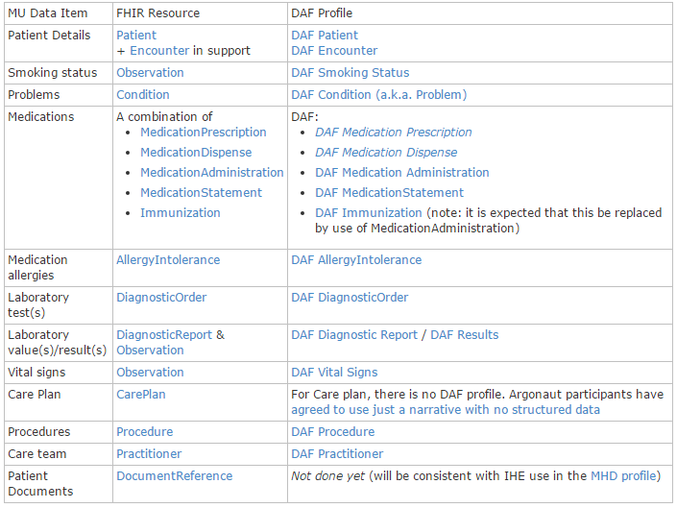
Argonaut Profiles
Based on DAF (for the Meaningful Use part

Slide 35
Argonaut Project
Strong testing/implementation focus now
Open to any participants
http://argonautwiki.hl7.org/index.php
Testing still ramping up

Slide 36
HSPC
Healthcare Services Platform Consortium
Wide set of interests around creating interoperable specifications
One specific interest: Plug-in framework for decision support/workflow assistance modules for EHRs
SMART on FHIR

Slide 37
HSPC
Build in DAF / Argonaut by being much more proscriptive about the content
Specify codes, reference ranges, allowable values, interpretation flags (e.g. like PITUS, but much wider)
All these things needed to create truly plug’n’play modules that don’t need to be re-written across systems (depends on how specific you want to be)
HSPC work has a longer pay-off cycle

Slide 38
The Challenge
Health insurance is a financial instrument used to settle health care claims, why can’t we “put the claims through with the ease of a credit card?”.
It’s what patients and providers said in 1990.
It’s what they still say today!

Slide 39
Claims Environment
Surprisingly similar around the planet:
Public healthcare tends to focus on medical, hospital, lab and pharmacy, private healthcare focus is on the rest: dental, vision, etc.
Providers (practitioners and institutions) are generally jurisdictionally licensed.
Practitioners work predominantly either in public institutions or in private practice.
Private practices often have 1-5 practitioners, some large clinics.
Third party insurance provides most private coverage.
Patient pays the balance after the public and private insurers.
Public funding is important but often a minor player.
There may no legislation mandating eClaims!

Slide 40
Claims Environment
Virtually ALL providers must submit ‘claims’ for reporting and generally for reimbursement purposes, yet:
Code systems are either non-existent or consistent within silos but locally derived.
Claim standards tend to be proprietary, jurisdictional, discipline specific or non-existent.
Batch claims are typically flat-file oriented.
In 1999 work began on a common set of eClaims for RealTime and Batch.
HL7 has eClaims messages in V2 and V3 for: Medical, Pharmacy, Oral Health, Vision, Chiro/Physio/Rehab, Hospital Billing – largely unused!
Country | Medical | Pharmacy | Dental
US | X12 - Batch | NCPDP - RealTime | X12 - Batch
Canada | Teleplan (13) - Batch | CPhA - RealTime | CDAnet - RealTime

Slide 41
Challenges with V2/V3 Claims
V2: not widely supported, not model based, ‘not-current’.
V3: not widely supported, large messages, complex, but
rich, broad, model based, xml rendered & implementable.
The V3 FICR messages have largely not been taken-up due to concerns of complexity with V3.
FHIR: not supported – yet, but simpler, smaller, easier to understand, to implement and to process.
While still in development, FHIR provides the opportunity to create something embraceable by existing eClaims systems personnel and implementable by new developers for both existing systems and new processes.

Slide 42
FHIR eClaim Resources
New Resources – not within FM scope:
Referral The referral, if any, to the servicing provider
VisionPrescription The prescription for Vision billing
New Resources – within FM scope:
Coverage The insurance being employed to receive reimbursement
Contract The insurance Policy is a profile on the Contract resource
Claim The services being claimed and supporting information
ClaimResponse The adjudicated response to the Claim, PreDetermination, PreAuthorization
Plus about 8 more resources to address eligibility, enrollment, payment, attachments and status checking.

Slide 43
Request/Response
RPC (Remote Procedure Call):
Send a request
Get a matching response
REST (Representational State Transfer)
Place a statement of state
Get an acknowledgement
The patterns differ in where state is – implicit or explicit

Slide 44
Exchanges: Example Patient Encounter
Business Provider Insurer
Activity Request Response__
Patient makes appointment
Provider checks coverage Eligibility EligibilityResponse
Patient arrives at office/clinic
Provider examines patient
Prepares treatment plan
Determines service coverage Claim ClaimResponse
Provider provides treatment
Send Patient’s claim Claim (use=complete) ClaimResponse

Slide 45
Request/Response & FHIR
Process implementation is not well understood in FHIR
Order/OrderResponse
*Order/*Request
ProcessRequest/ProcessResponse
We delayed resolving these issues in order to get MU/EHR core resources more stable
Main focus of next FHIR release

Slide 46
Request/Response in Finance
Claim / ClaimResponse is not the same as RPC Request/Response
Claimant posts claim to server
Server accepts claim, then processes in background, then posts response
Claimant polls for response
They refer to a higher level discussion
Depends on sense of perspective

Slide 47
Financial Resources
Main focus USA/Canada
Some European review
No Australian input?

Slide 48
Insert David’s Slides here (Terminology Services)

Slide 49
Lunch

Slide 50
Connectathons
History
Culture
Tomorrow

Slide 51
Connectathon History
Soapbuilders Forum – make a poor specification fly
https://groups.yahoo.com/neo/groups/soapbuilders/info
http://www.whitemesa.com/interop.htm
Iterative development of a public standard requires public testing
FHIR enabled that

Slide 52
First Connectathon (0)
May 2012
A few of us talking about how it would be really good to have exchange based on publically available servers
A partially successful attempt to exchange an actual resource.
Lots of changes to the specification
We laid out a template for HL7 run connectathons which is mostly still followed today

Slide 53
Connectathon 1
Sept 2012
10 or so participants
Real exchange of patient resources
Keith’s write up: http://motorcycleguy.blogspot.com.au/2012/09/successes-at-hl7-fhir-connectathon.html

Slide 54
Current Connectathons
Typically, 70 or so participants
That’s pretty much capacity (~1TB data)
Compere: David Hay
Multiple Streams
Beginners level : Patient registration
Terminology Services
Other topics of interest (Documents, Allergies, Questionnaire, Conformance, v2 Message Conversion etc)

Slide 55
Scenarios
Each stream has a ‘scenario’ – a rough story board for implementers to follow
Storyboard may have associated data, resources, messages, or test scripts
Because we are testing the API, not the applications, we are always flexible about the actual content (more variety is good)

Slide 56
Connectathon Goals
Tutorial: Learn by doing
Most community leaders started at a connectathon
Test that the base specification says what’s needed for interoperability to work
Connectathons create tasks to fix the product
Test whether domain functionality is appropriate, and hone scenarios to encourage cross-testing applications
Create Expectations about products to drive convergence in applications

Slide 57
Connectathon pre-requisites
You need some development environment that can exchange resources
Real Healthcare Application
Empty Prototype
Java/C#/Ruby/python/javascript/tcl/visual basic
POSTman (demonstration)

Slide 58
Tomorrow’s Connectathon
Stream 1: Patient Registration Scenario (starter)
Stream 2: v2 Message -> FHIR conversion (for v2 specialists – who isn’t?)
Stream 3: Terminology Services (provider/consumer/specialist)
http://wiki.hl7.org/index.php?title=FHIR_Connectathon_Brisbane

Slide 59
Patient Stream
Search for a Patient
Register a new patient
Update the patient resource
See the history of changes to the patient resource (optional)
Clients: test against public servers first
Servers: use POSTman to compare to public servers

Slide 60
V2 Message Conversion
Start with a message (2 samples on the wiki if you want)
Convert the message to FHIR resources
Can do in code, or manually using a text editor
Figure out the matching FHIR resources for segments
Use v2 mappings to help migrate the data
Figure out how to convert segments to FHIR operations (treat FHIR server as target CDR)
POST to server using code or POSTman

Slide 61
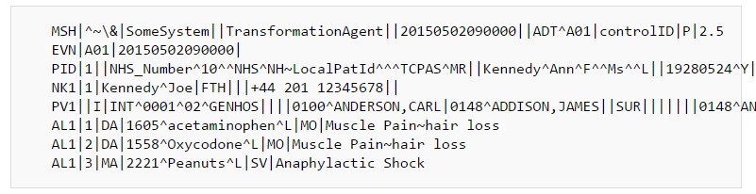
Conversion Issues
PID + NK1 → Patient
PV1 → Encounter
AL1 → AllergyIntolerance
Work from v2 mappings page
Issues: Injecting namespaces, remediating identifiers, business logic?

Slide 62
Transaction Issues
Does Patient already exist? (conditional create? Update?).
Is there more than one NOK?
Does Encounter already exist?
Are allergies a snapshot?
How do you maintain them between messages?
How do ensure integrity on the server?

Slide 63
Terminology Services
Scenarios:
do a value set expansion of one of the value sets in the specification (with text filter)
validate a code using the spec against a FHIR value set, a v2 value set, or LOINC or SNOMED CT
look up a display for a code (most appropriate for v2/FHIR conversion)
translate a code from a custom code system to SNOMED CT

Slide 64
Terminology Services
Tools
Snapper can create value sets and concept maps
Servers:
http://fhir-dev.healthintersections.com.au/open
http://ontoserver.csiro.au/fhir
Demo…

Slide 65
Connectathon Tomorrow
Based on http://hl7.org/fhir/2015May/index.html
You can participate in as many tracks as you like
Or you can do something else
but support might be bit thin
For non-technical people, you can try out the clinical connectathon

Slide 66
Insert David’s Slides here (Clinical Connectathon)

Slide 67
FHIR in Australia
Existing Implementation work
Future Adoption
Management of Australian Localization

Slide 68

Existing Australian Implementations
Oridashi (Brett Esler) - Hiasobi FHIR server
multiple primary care systems.
FHIR REST based read-only interfaces and resource representations
creates a common methodology for application vendors seeking plug-and-play capability.
Build once, many primary care systems.
Remove cost of custom data interfacing.
Focus on end user value, not data access.
Open new markets for applications where FHIR servers are available
http://oridashi.com.au/site/demo.html

Slide 69


Existing Australian Implementations
MyCareManager
Telehealth platform with client and provider portals using FHIR as the integration technology
TCM
Publishing content to the MyCareManager Client Portal
ConnectingCare.com
Questionnaire template design and entry
sqlonfhir (name subject to approval)
Generic FHIR server built on SQL Server
Designed to sit in front of existing products and provide a caching FHIR server capability

Slide 70
Existing Australian Implementations
http://*.healthintersections.com.au
My test server(s) – mainly intended to support community growth
Other implementers run server to support their internal testing & development
Including several universities around the world
Open source/free

Slide 71
Prospective Australian Implementations
National Program – considering FHIR
NEHTA tooling development Implementation Guide:
http://hl7-fhir.github.io/nehta.html
National Terminology Service – expected to include FHIR interface

Slide 72
Prospective Australian Implementations
Various EHR vendors considering using FHIR / Smart-on-FHIR internally
Various Australian Projects discussing using FHIR for convenience
MSIA group discussing adapting Argonaut to Australian conditions

Slide 73
Prospective Australian Implementations
An important part of FHIR is open-ness and community engagement
IG tools are coming along slowly
Community is running ahead of tools because of Connectathons / other engagement approaches
Plan to use these if you plan to use FHIR

Slide 74
Managing FHIR in Australia
A connectathon production line
Naming Systems Registry
Australian Terminology Support
Australian Extensions
Australian Profiles
These are technical resources that support Australian projects and standards

Slide 75
Naming Systems
Common Australian Identifiers
IHI, HPII, HPIO
Prescriber / Provider Numbers, Medicare Number
Everyone’s numbers
Australian Terminologies
PBS MBS MIMS DOCLE ICPCX etc
Need to agree & publish how to represent them

Slide 76
Australian Terminology Support
Common Australian Terminologies
What’s the license?
How are they used?
How are they distributed?
What kind of support should terminology servers provide?

Slide 77
Australian Extensions
Support Australian specific requirements
ATSI status
Reg 24, other regulatory things
Project Specific things
Projects can do their own, but support would make their experience better & more reproducible
Need a governance / publication process
Opt-in! … has to provide value

Slide 78
Australian Profiles
Similar to extensions, but different life cycles and governance
Capturing agreements about how content is represented (including, e.g. PITUS)
Need governance / publication process
Use International Registry? Australian registry?

Slide 79
Managing Australian Content
At present:
HL7 Australia maintains a wiki page
Brett Esler is the contact
Discussions on HL7 Australia email list (none yet)
Draft: http://fhir.oridashi.com.au/aus/index.php?title=FHIRAU
The process and the tooling support will need to scale up in the near future

Slide 80
Afternoon Break

Slide 81
Insert David’s Slides here (FHIR in NZ)

Slide 82
Future Directions for FHIR
Community Process: Storming, Norming, Conforming
FHIR-core is coming to the end of the Storming process
Community is growing rapidly
Changing the specification is already much harder than it was
Future changes will have even more cost

Slide 83
Future Directions for FHIR
Some parts at the start of the storming phase
These need to keep changing
More DSTUs in the future?
Normative is over the horizon
Need a process to restrain change
Linked to the Maturity Model

Slide 84
Future Directions for FHIR
Technical Content Changes:
API – mainly security bindings (digital signatures!), application context linking
Definitions – much work to broaden and deepen the ontological base (RDF, terminologies, reasoning tools)
Conformance – more expressivity, better tools

Slide 85
Future Directions for FHIR
Domain Content changes
Near Term: focus on Workflow
Ongoing refinements for clinical integration
Clinical Decision Support Rules
More kinds of data to support new exchanges
More Integration of primary and secondary use
Significant work on genetics and personalised medicine (see Michael’s Appendix)
Best Practice Guides

Slide 86
Future Directions for FHIR
Community
Move community focus & tools to http://fhir.org
Consolidation after Rapid Growth
Ability to scale the core team to support much more implementation (more servers, more connectathons, more users)
Dealing with the trough of disillusionment
FHIR don’t solve real disagreements

Slide 87
Future Directions for FHIR
In Australia
Increasing Adoption
Leverage Argonaut Development
Governance of Australian content

Slide 88
Discussion

